Slide 1
The Science of Climate Change
Eugene S. Takle
Professor of Atmospheric Science
Professor of Agricultural Meteorology
Director, Climate Science Program
Iowa State University
Ames, IA 50011
Illinois Farm Bureau
Commodities Conference
28 July 2010
Normal, IL

Slide 2
Climate change is one of the most important issues facing humanity
The scientific evidence clearly indicates that our climate is changing, and that human activities have been identified as a dominant contributing cause.
Don Wuebbles
Notes:
No disagreement in peer reviewed literature
Powerful statements from every major professional science society and organization in the world
Powerful statements from the National Academies of Sciences (the leadership in science) for every major country
G8 + 5 other countries, May 2009: “The need for urgent action to address climate change is now indisputable.”

Slide 3
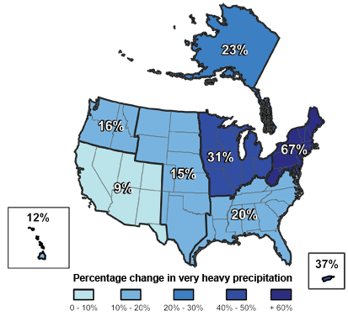
Climate changes are underway in the U.S. and are projected to grow
Temperature rise
Sea-level rise
Increase in heavy downpours
Rapidly retreating glaciers
Thawing permafrost
Lengthening growing
season
Lengthening ice-free season
in the ocean and on lakes
and rivers
Earlier snowmelt
Changes in river flows
Plants blooming earlier; animals, birds and fish moving northward
Don Wuebbles

Slide 4
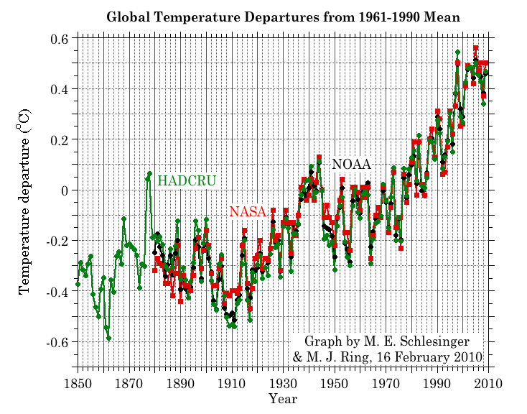
Three separate analyses of the temperature record – Trends are in close agreement
Don Wuebbles

Slide 5
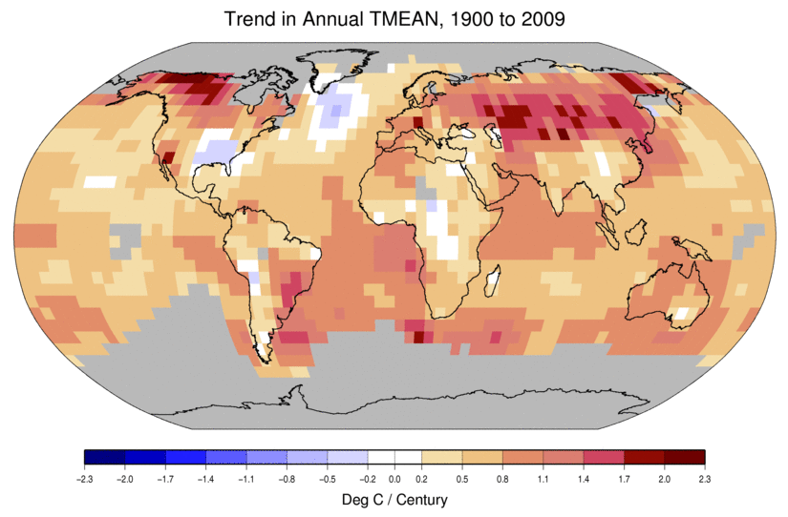
Temperature Changes are Not
Uniform Around the Globe
From Tom Karl, NOAA NCDC

Slide 6
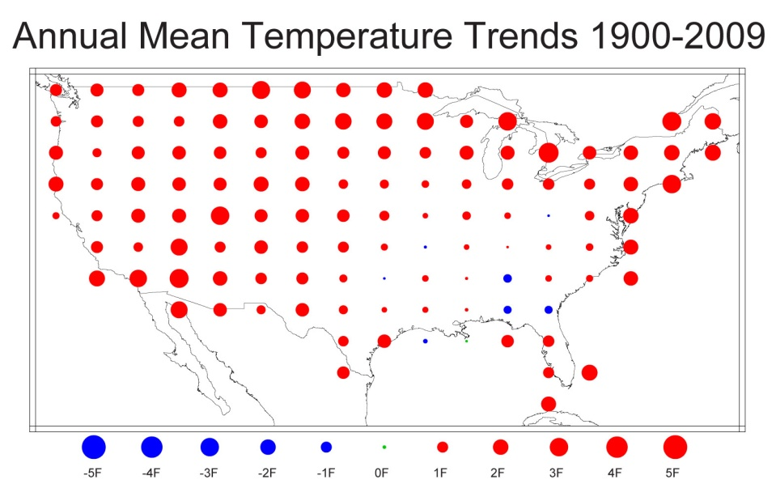
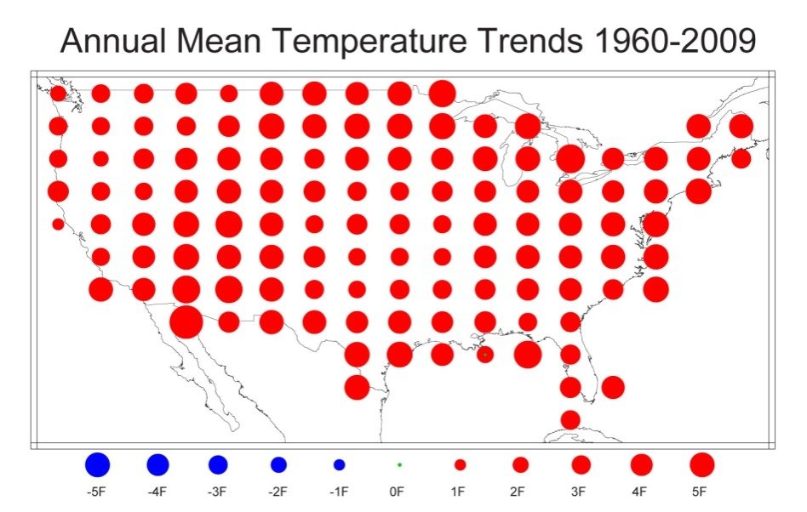
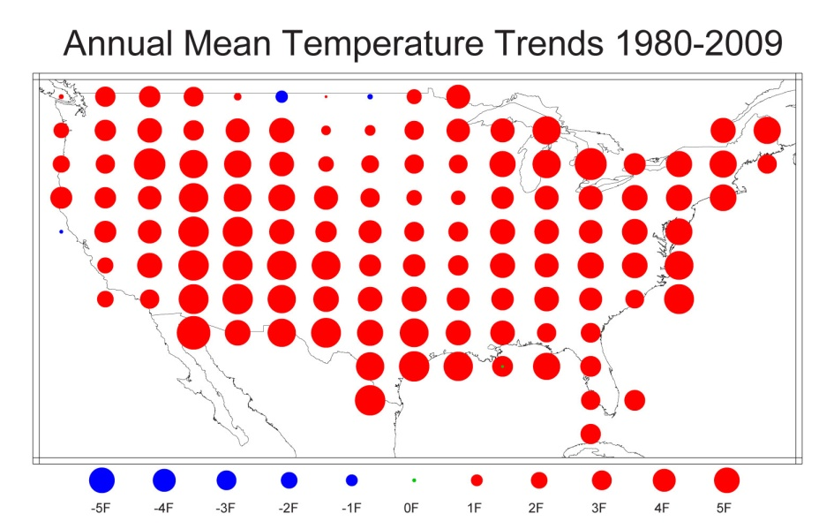
U.S. Temperature Trends
U.S. average temperature has risen more than 2ºF over the past 50 years
From Tom Karl, NOAA NCDC

Slide 7
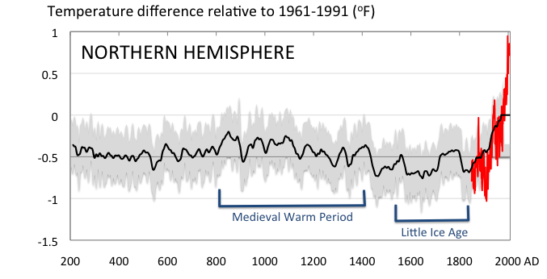
Conditions today are unusual in the context of the last 2,000 years …
Don Wuebbles

Slide 8
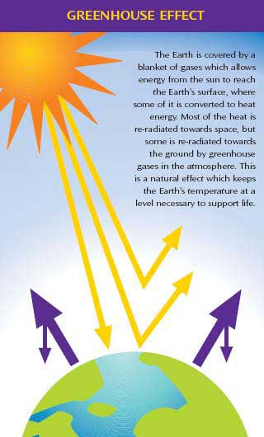
Why does the Earth warm?
1. Natural causes
THE GREENHOUSE EFFECT…
…is 100% natural.
  Heat is trapped in the atmosphere.
…sustains life on Earth.
  Keeps average temperatures at 12.8ºC (55ºF), instead of –29ºC (-20ºF).
Don Wuebbles

Slide 9
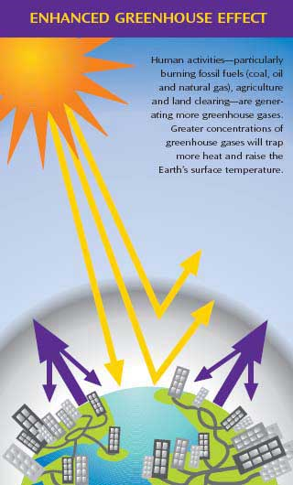
Why does the Earth warm?
2. Human causes
THE ENHANCED GREENHOUSE EFFECT
(or GLOBAL WARMING)
… is primarily human-induced: We’re increasing heat-trapping gases in the atmosphere.
… is like wrapping an extra blanket around the Earth.
Don Wuebbles

Slide 10
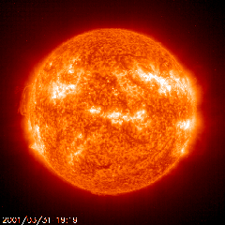
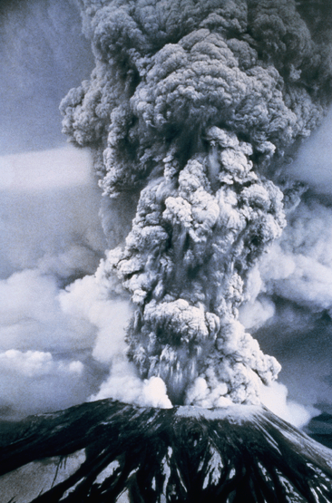
Natural factors affect climate
Variations in the energy
received from the sun
Variations in the Earth's orbit
(Milankovic effect)
Stratospheric
aerosols from
energetic
volcanic eruptions
Chaotic interactions in
the Earth's climate
(for example, El Nino, NAO)
Don Wuebbles

Slide 11
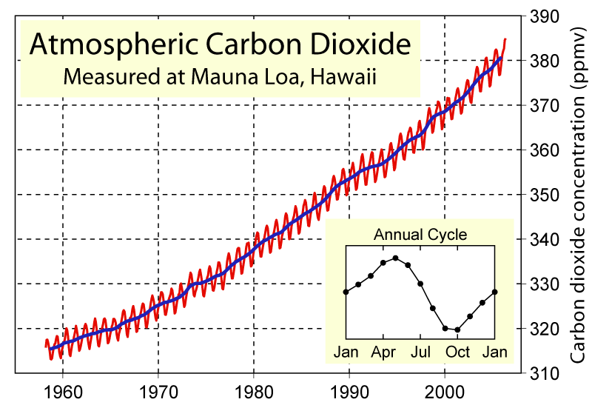
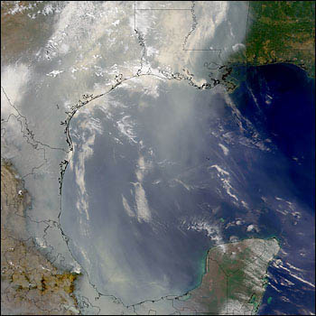
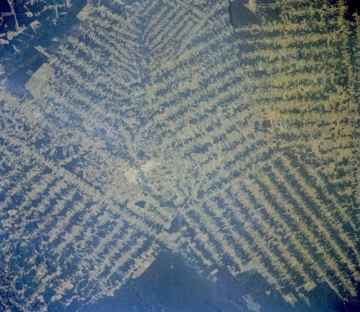
Non-natural mechanisms
Changes in atmospheric concentrations of radiatively important gases
Changes in aerosol particles from burning fossil fuels and biomass
Changes in the reflectivity (albedo) of the Earth’s surface
Don Wuebbles

Slide 12
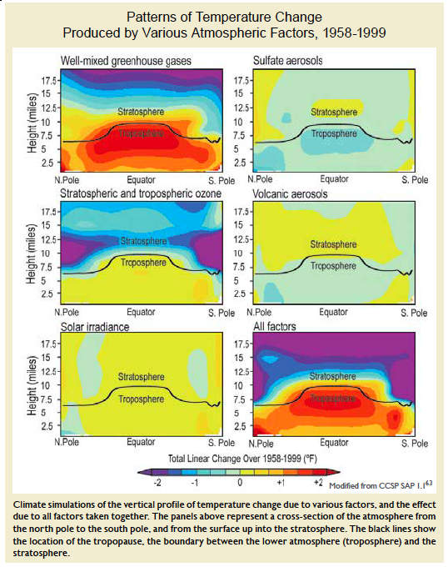
Warming of the Lower and Upper Atmosphere Produced by Natural and Human Causes
Note that greenhouse gases have a unique temperature signature, with strong warming in the upper troposphere, cooling in the lower stratosphere and strong warming over the North Pole. No other warming factors have this signature.
Karl, T. R., J. M. Melillo, and T. C. Peterson, (eds.), 2009: Global Climate Change Impacts in the United States. Cambridge University Press, 2009, 196pp.

Slide 13
Many lines of evidence for conclusion of a “discernible human influence”
“Basic physics” evidence
  Physical understanding of the climate system and the heat-trapping properties of greenhouse gases
Qualitative analysis evidence
  Qualitative agreement between observed climate changes and model predictions of human-caused climate changes (warming of oceans, land surface and troposphere, water vapor increases, etc.)
Paleoclimate evidence
  Reconstructions of past climates enable us to place the warming of the 20th century in a longer-term context
Fingerprint evidence
  Rigorous statistical comparisons between modeled and observed patterns of climate change
Don Wuebbles

Slide 14
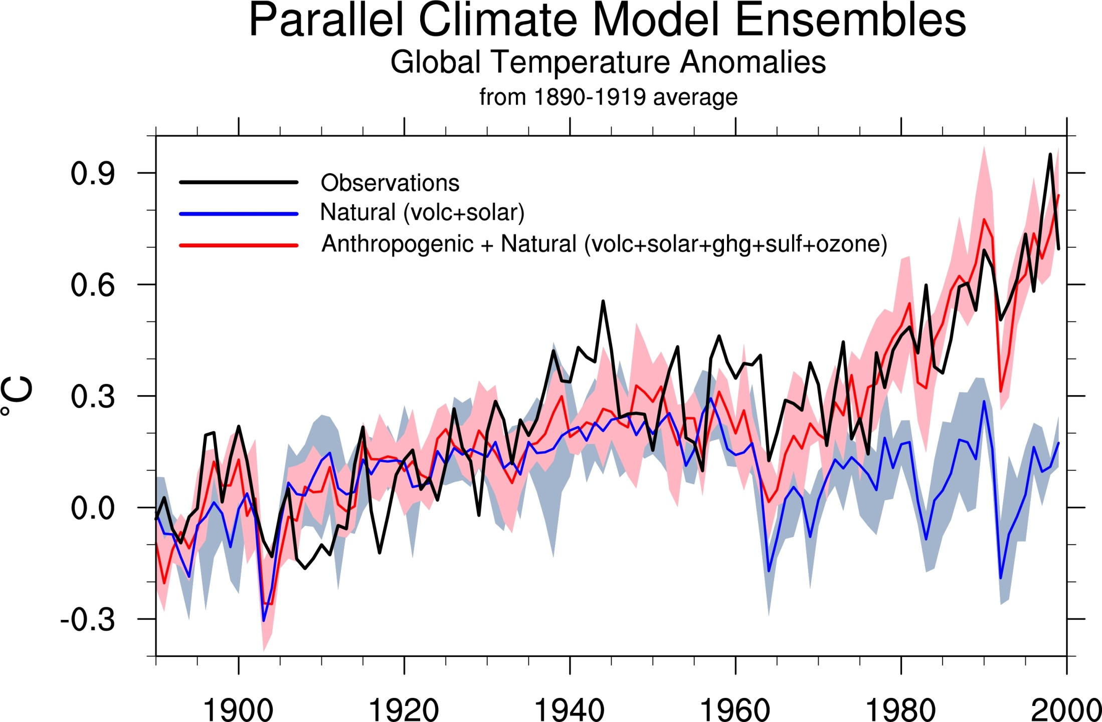
Climate models: Natural processes do not account for
observed 20th century warming after 1965
Don Wuebbles

Slide 15
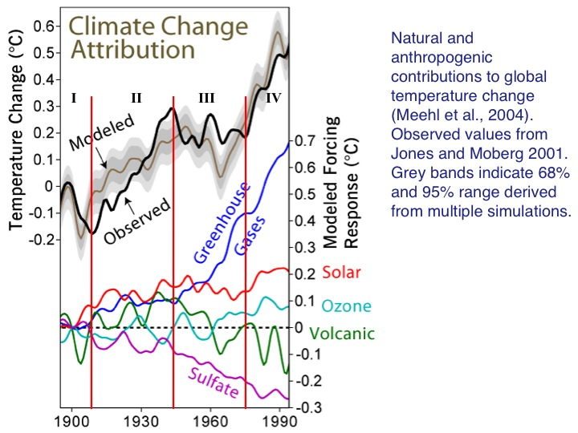

Slide 16
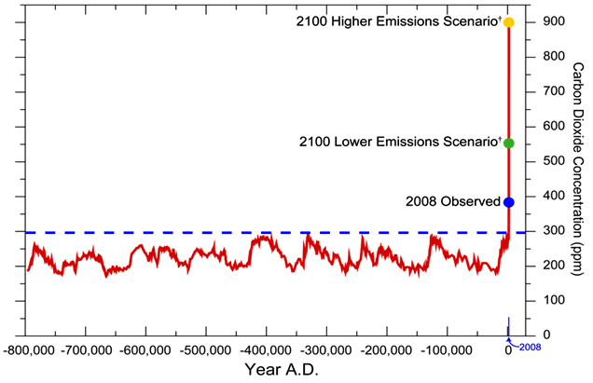
We have Moved Outside the Range of Historical Variation
800,000 Year Record of Carbon Dioxide Concentration
Don Wuebbles

Slide 17
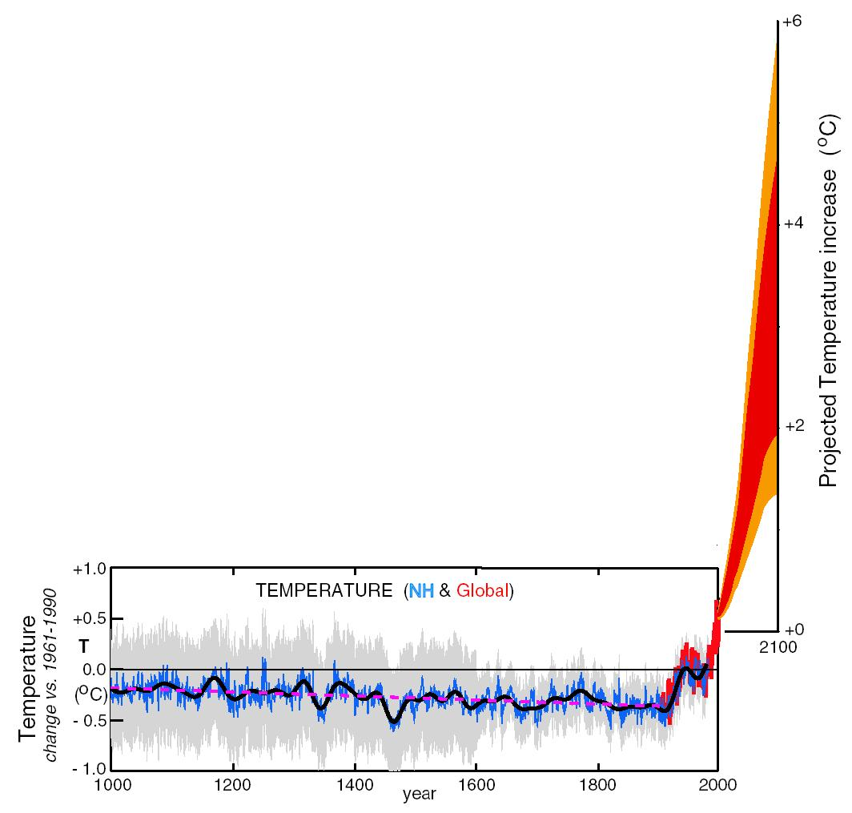
What can we expect in the future?
Don Wuebbles

Slide 18
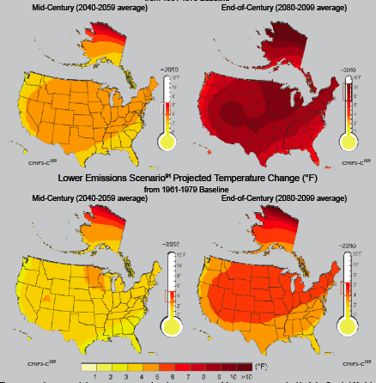
Projected US Surface Air Temperature
High
Emission
Scenario (A2)
Low
Emission
Scenario (B1)
Don Wuebbles
Notes:
Temperature changes relative to the 1961-1979 average. After mid-century, significant differences between the scenarios emerge. On the bottom, the low emissions scenario (B1). On the top, the high emissions scenario (A2). Left panel are mid-century, right panels are the end century. Scale is Fahrenheit.

Slide 19
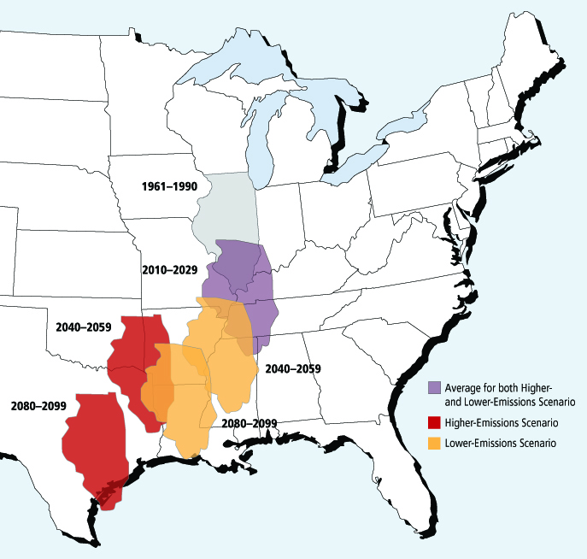
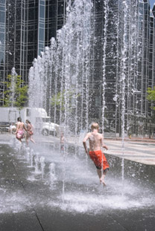
Migrating Illinois Climate
Based on summer average temperature and precipitation
Don Wuebbles

Slide 20
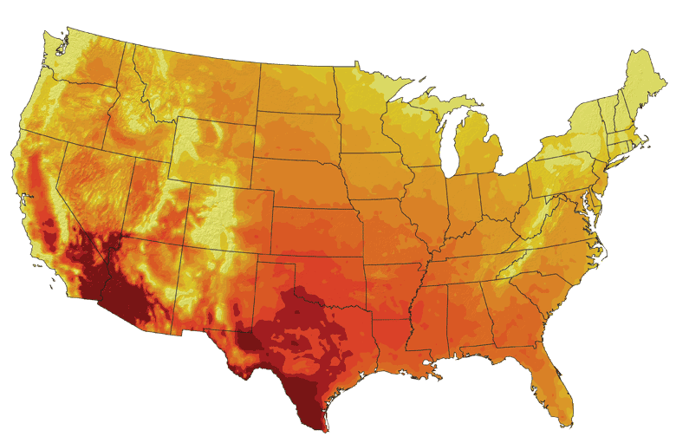
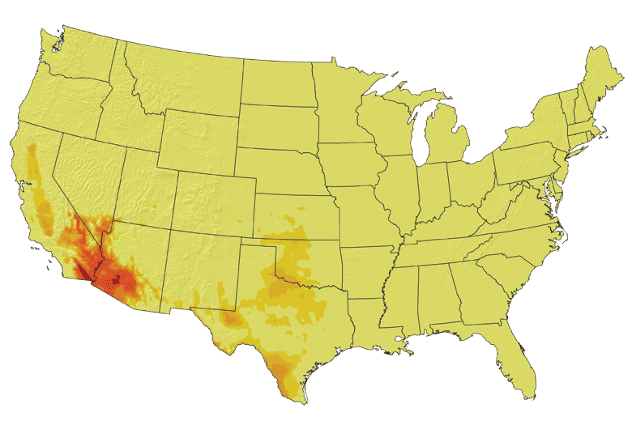
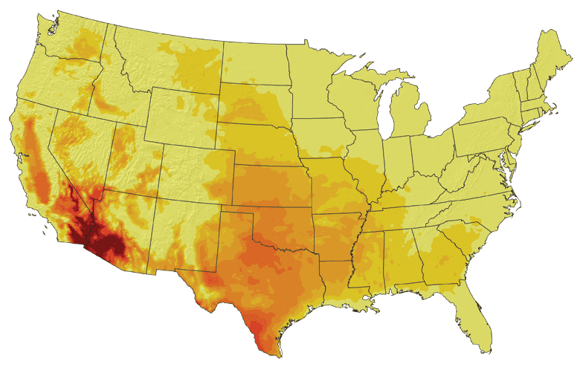
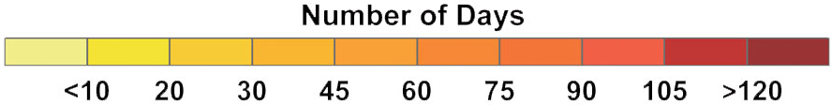
Increases in very high temperatures will have
wide-ranging effects
Higher Emissions Scenario, 2080-2099
Number of Days Over 100ºF
Recent Past, 1961-1979
Lower Emissions Scenario, 2080-2099
Don Wuebbles

Slide 21
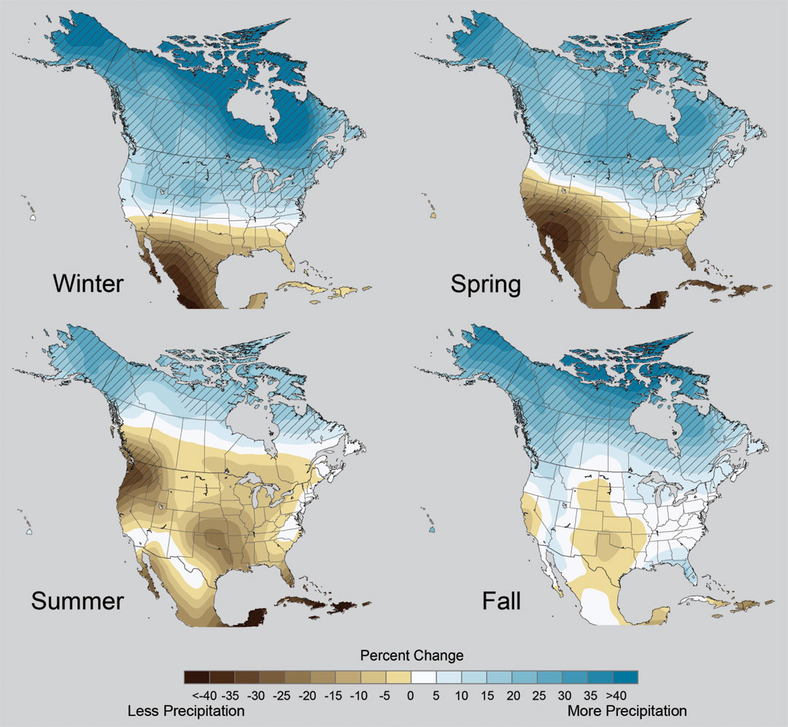
Projected Change in Precipitation: 2081-2099
Midwest: Increasing winter and spring precipitation, with drier summers
More frequent and intense periods of heavy rainfall
Unstippled regions indicate reduced confidence
Relative to 1960-1990
NOTE: Scale Reversed
Don Wuebbles

Slide 22
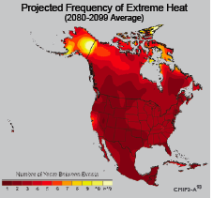
Extreme weather events become more common
Events now considered rare will become commonplace.
Heat waves will likely become longer and more severe
Droughts are likely to become more frequent and severe in some regions
Likely increase in severe thunderstorms (and perhaps in tornadoes).
Winter storm tracks are shifting
northward and the strongest storms are
likely to become stronger and more
frequent.
Don Wuebbles
Notes:
Shown here is the frequency at the end of the century of what we consider now to be a 20 year heat wave. Instead of once every 20 years, these temperatures would be experienced every other year or so over most of the continental US in this business as usual scenario.

Slide 23
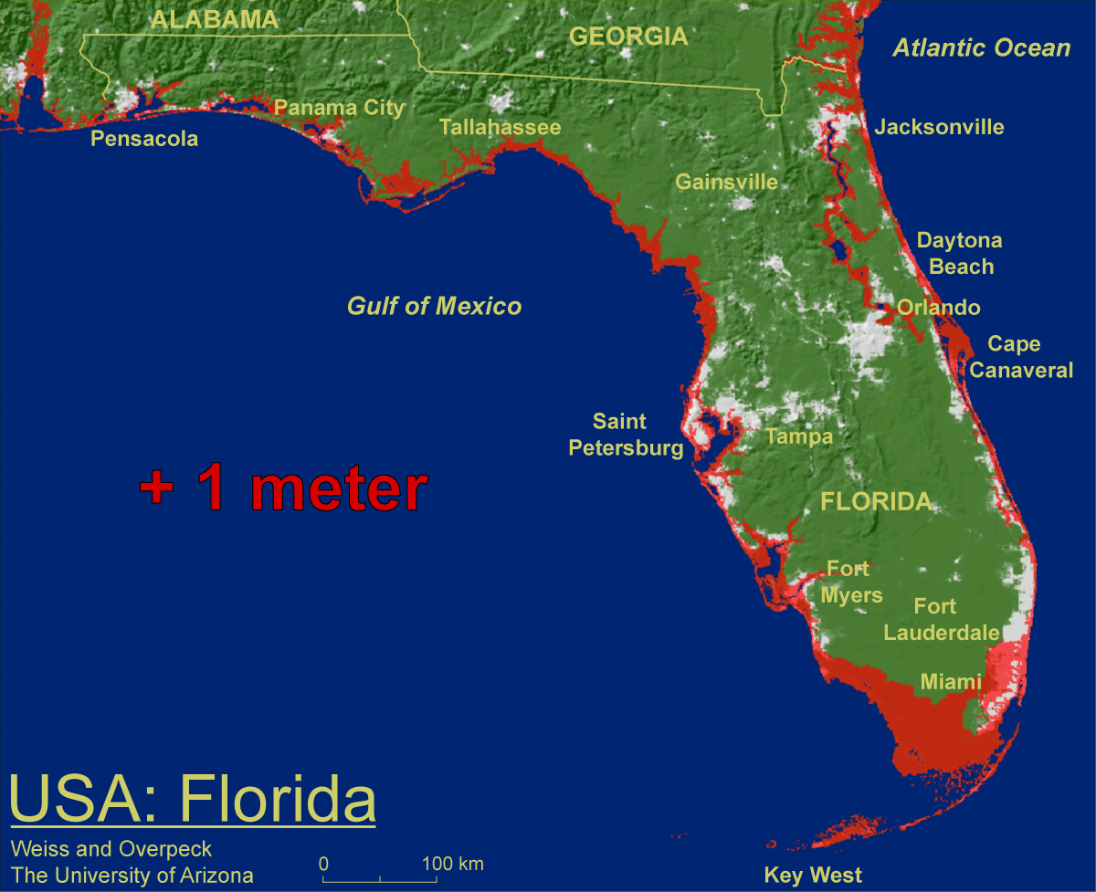
1 meter will be hard to avoid, possibly within this century, just from thermal expansion and small glacier melt.
Don Wuebbles

Slide 24

Widespread climate-related impacts are occurring now and are expected to increase
Water Resources
Energy Supply & Use
Transportation
Agriculture
Don Wuebbles
Ecosystems
Human Health
Society

Slide 25
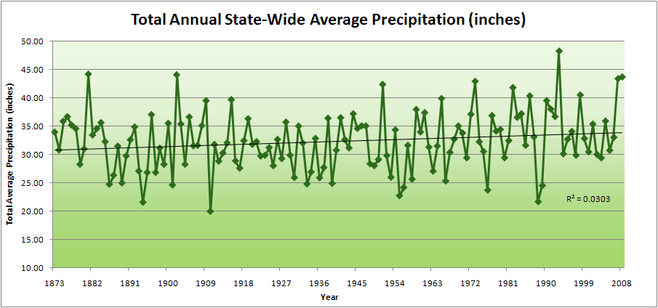
Iowa State-Wide Average Data

Slide 26
Iowa State-Wide Average Data
34.0”
8% increase
31.5”

Slide 27
Iowa State-Wide Average Data
Totals above 40”
2 years

Slide 28
Iowa State-Wide Average Data
Totals above 40”
8 years
2 years

Slide 29
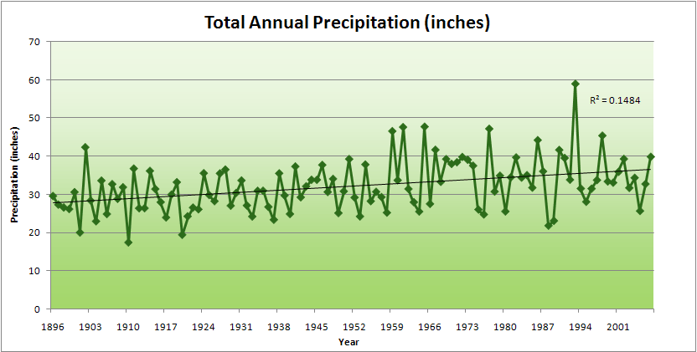
Cedar Rapids Data

Slide 30
Cedar Rapids Data
28.0”
32% increase
37.0”

Slide 31
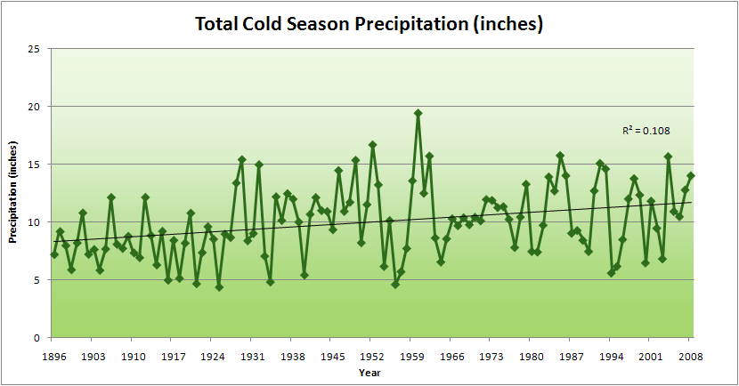
Cedar Rapids Data
51% increase
11.8”
7.8”

Slide 32
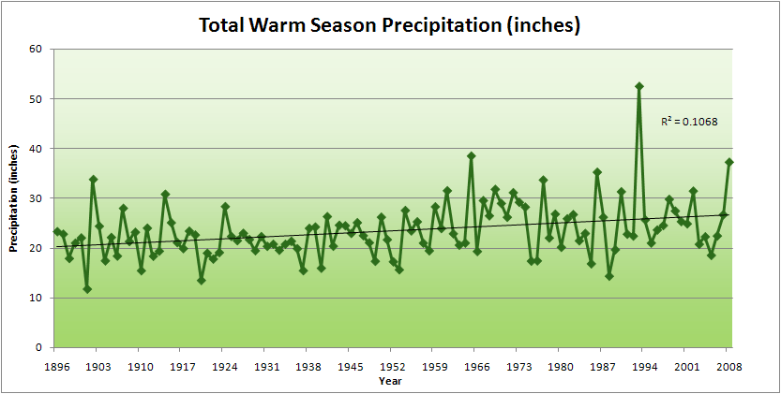
Cedar Rapids Data
34% increase
26.8”
20.2”

Slide 33
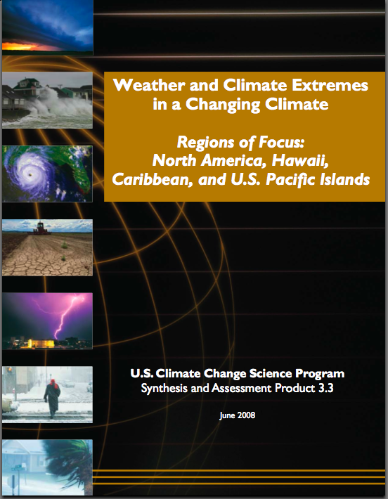
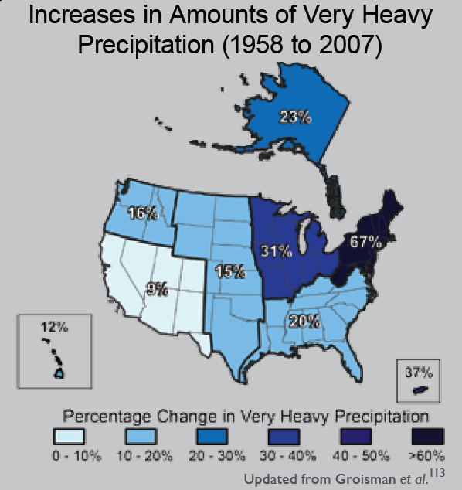
“One of the clearest trends in the United States observational record is an increasing frequency and intensity of heavy precipitation events… Over the last century there was a 50% increase in the frequency of days with precipitation over 101.6 mm (four inches) in the upper midwestern U.S.; this trend is statistically significant “
Karl, T. R., J. M. Melillo, and T. C. Peterson, (eds.), 2009: Global Climate Change Impacts in the United States. Cambridge University Press, 2009, 196pp.

Slide 34
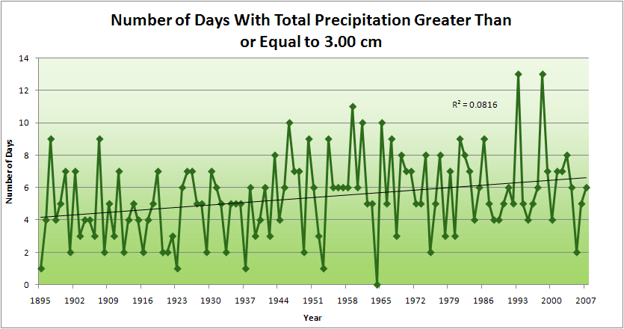
Cedar Rapids Data
4.2 days
57% increase
6.6 days

Slide 35
Cedar Rapids Data
Years having more than 8 days
11
2
4.2 days
57% increase
6.6 days

Slide 36
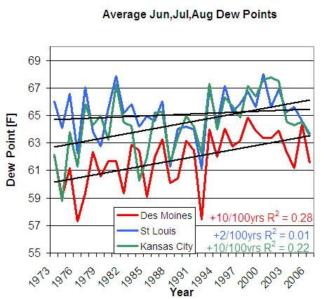
D. Herzmann, Iowa Environmental Mesonet

Slide 37
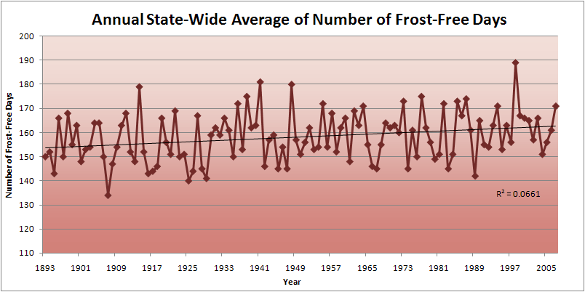
Iowa State-Wide Average Data

Slide 38
Iowa Agricultural Producers’ Adaptations to Climate Change
Longer growing season: plant earlier, plant longer season hybrids, harvest later
Wetter springs: larger machinery enables planting in smaller weather windows
More summer precipitation: higher planting densities for higher yields
Wetter springs and summers: more subsurface drainage tile is being installed, closer spacing, sloped surfaces
Fewer extreme heat events: higher planting densities, fewer pollination failures
Higher humidity: more spraying for pathogens favored by moist conditions. more problems with fall crop dry-down, wider bean heads for faster harvest due to shorter harvest period during the daytime.
Drier autumns: delay harvest to take advantage of natural dry-down conditions
HIGHER YIELDS!!
Is it genetics or climate? Likely some of each.

Slide 39
For More Information
Contact me directly:
gstakle@iastate.edu
Current research on regional climate and climate change is being conducted at Iowa State University under the Regional Climate Modeling Laboratory
http://rcmlab.agron.iastate.edu/
North American Regional Climate Change Assessment Program
http://www.narccap.ucar.edu/
For current activities on the ISU campus, regionally and nationally relating to climate change see the Climate Science Initiative website:
http://climate.engineering.iastate.edu/
Or just Google Eugene Takle

